Slide 1


Highly stable rotating machine models
using the state-space-nodal real-time solver
Christian Dufour
OPAL-RT Technologies, Montréal, Québec, Canada
COMPENG-2018, Firenze, Italy

Slide 2
Work objective and motivation
Many popular simulation tools for transient simulation of motor drive, converters and power systems are based on the state-space formulation SimscapePowerSystems (formerly SimPowerSystems for Simulink, SPS) and PLECS are like this
Machine modeling in this approach is made with current injection into the state-space systems. This injection induces a delay between machine and linear part of the network.
This delay of injection force users to add a minimum parasitic load or RC-snubber at the machine terminals to be stable under light load or open-phase condition.
Using the State-Space-Nodal (SSN) approach, we solve this issue in SPS.
The main reason is that SSN is an implicit solver that has no delay in the solution between machine parts and linear ABCD parts.

Slide 3
On the utility of real-time simulation in industry

Slide 4


Modern controlled-process design methodology
Let’s consider the design of an aircraft.
Cost Billions$ to design and manufacture.
Can we wait until the first flight test to verify it actually fly?
Consider now a large power grid
Again, it can cost $billions to design
Can we wait until commissioning to make sure
it is stable and robust?

Slide 5
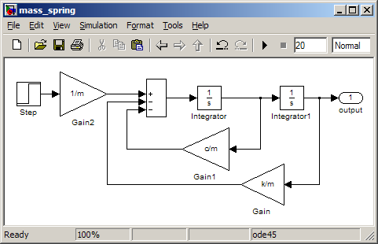
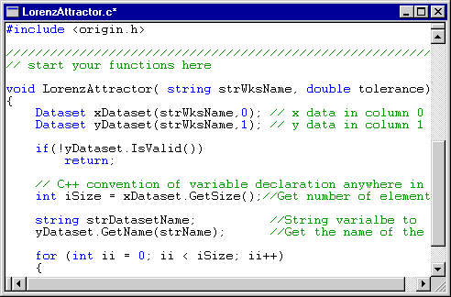
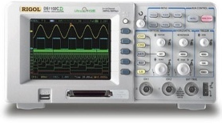
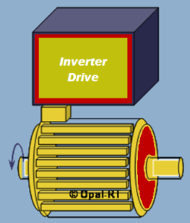
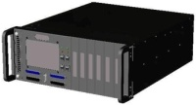
Model-based Design (simplified)
Model-based design: system specification, design, validation, integration based entirely on models
Model and solver quality are increasingly important.
MATLAB/ Simulink is the world leader in model-based design tools.
  ARTEMiS-SSN is primarily a Simulink SimPowerSystems blockset
Controller Model Design (Simulink Block Diagram)
Correct Design Iteratively
Generate Software from Model
automatically
Upload Software
to Real-Time
Simulation Platform
Test
Notes:
With the modern advances in modern simulation software technologies, a new paradigm about controller design methodology called ‘ Model-Based-Design’ has emerged.
In this approach, an control engineer will design a control model in a graphical interface of a simulation tool such as Simulink and verify it’s functionality by offline simulation. Then, on a push of a button, the software will automatically generate executable code to be run a target platform. Then, the enginner can test if his model works correctly. If not, he simply has to modify his model and restart the whole process.
This enable the design loop to be much faster than previously feasable, mainly because C code generation no longer has to be made manually.
The test method dexcribed above is also used after release, during firmware update for example.

Slide 6

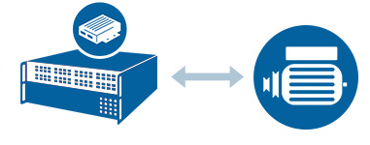



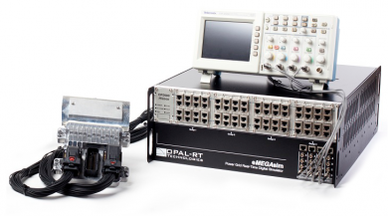
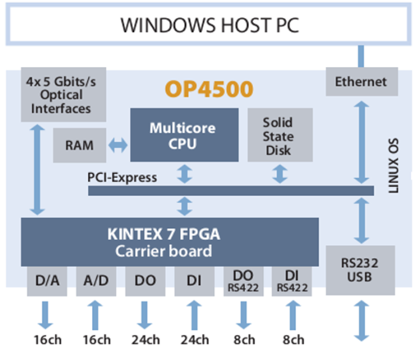
Model-based design and real-time simulators
Specification by models
Calibration & release
Controller validation
using real-time simulated
System (HIL and PHIL)
Controller design
Up to production-type
Implementation
(Rapid Control Prototyping)
Control Prototyping
Hardware in-the-loop
Typical real-time
simulator internal
structure
Implementation
Controller HIL testing
using a real-time
simulator
Subsystem integration using
connected HIL simulators

Slide 7
General objective of modern design methodology
Objective is to make sure that design flaws are found and corrected as early as possible
Rate of defect discovery
New
Old
Req.
Design
Implement
Validation
The later the detection, the more expensive the correction
SSN, Simulink, real-time simulators are all parts of this approach

Slide 8
About SSN
About machine models

Slide 9
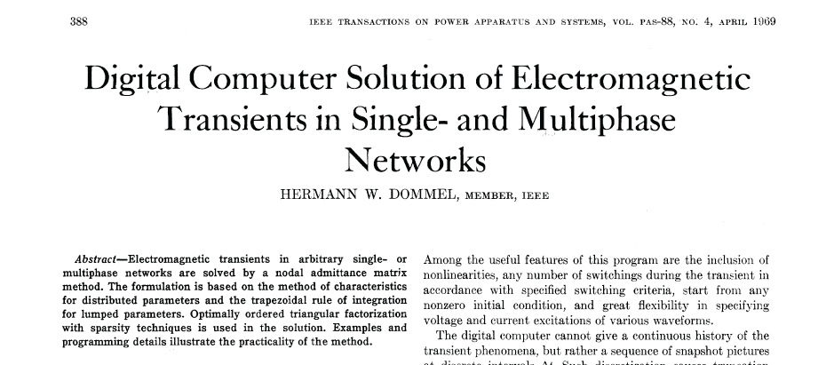
SSN: state-space method in EMTP
The State-Space-Nodal (SSN) is much like Dommel’s EMTP
Differences in SSN:
  Branches/groups/partitions are user defined
  Branches/groups/partitions use state-space ABCD formulation
ARTEMiS-SSN is real-time add-on to Simulink SimPowerSystems blockset.

Slide 10
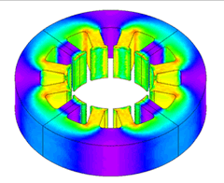
FEA-based Model vs. DQ Model
Most real-time compatible machine models are of dq- or dq0- Type (i.e. Uses Park transforms)
This is the case of SSN machines models (as well as SPS, PLECS, Typhoon, etc…)
Impossible to run it in real-time (RT)
Saturation effect,
Complex geometry
Can be simulated in Real-Time
FEA model
 Very accurate
× Slow
Accuracy of Motor Model
d axis
Simplified saturation,
Sinusoidal backEMF,
No slot effects
q axis
dq model
 Accurate enough
 Fast
Very slow
Hours ~ Minutes
Very fast
Micro ~ Nano sec
Calculation Speed

Slide 11
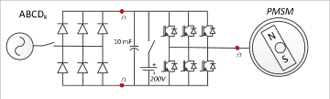
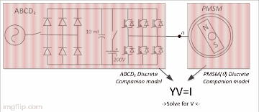
Machine solver methods
State-Space solver integrate machine equation ‘naturally’, by integrating input machine voltages and injecting resulting currents into ABCD (linearization #k)
This result in an ‘alternating’ solution between machines and main linearized ABCD parts
Ex: SPS, PLECS
In nodal admittance matrix based methods, machines and main linearized circuit parts first provide their respective discretized Thevenin equivalents.
Common voltage points are solved simultaneously by Kirchhoff's laws using a nodal admittance matrix.
Ex: SSN, EMTP-RV
Notes:
This part of the presentation (History of the work and motivation) contains Introduction and Section III and Section IV.A of the paper.

Slide 12
Paper highlights

Slide 13
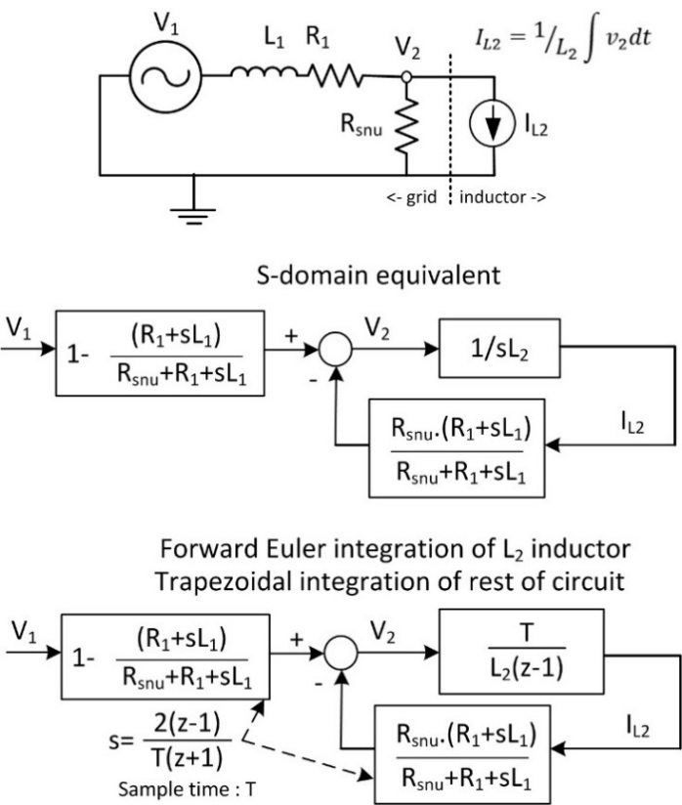
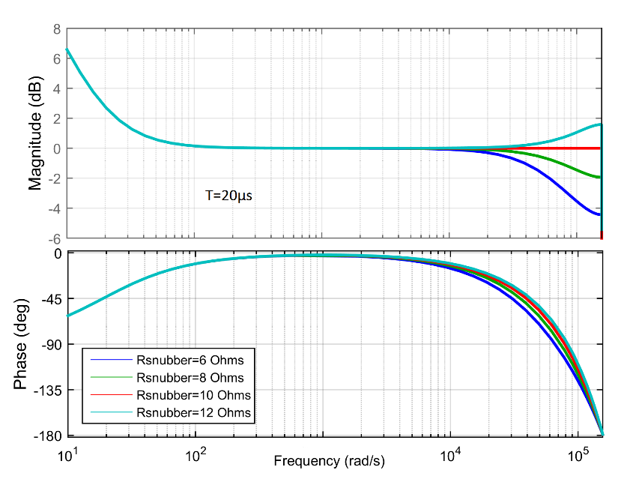
State-space method remedy for machines: RC-snubbers
To stabilize a machine model in a State-Space solver, one will often put minimal load or an RC-snubber
This affects negatively the accuracy of the model
In the paper, Bode analysis is used to explain and understand the stability problem of the machines in the state-space approach.
12Ω: unstable
8Ω: stable
180 deg shift
Notes:
This part of the presentation (History of the work and motivation) contains Introduction and Section III and Section IV.A of the paper.

Slide 14
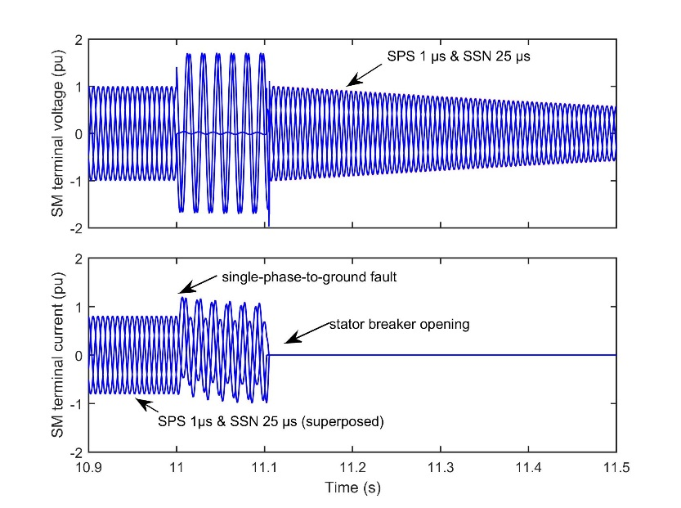
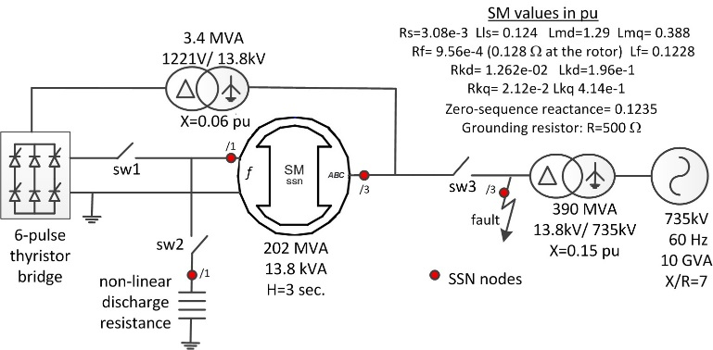
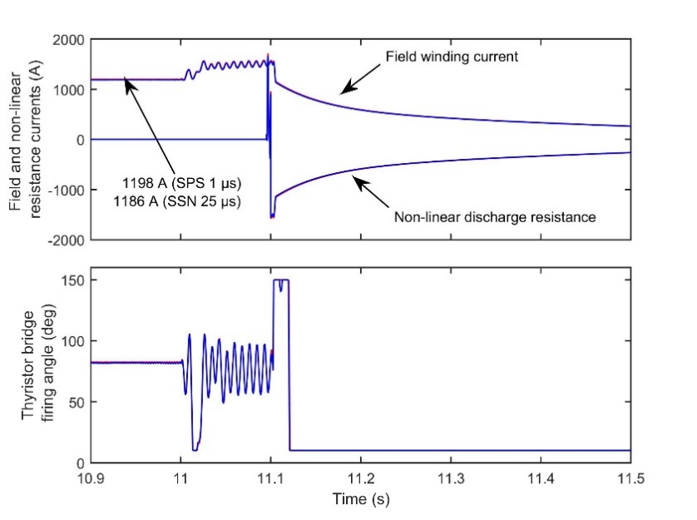
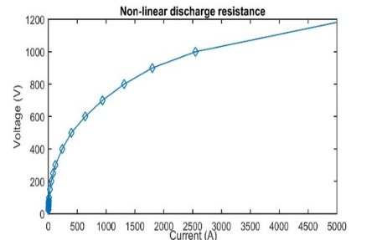
SSN Synchronous machines
SSN model @ 25 µs matches perfectly SPS model running at 1µs
Main SSN improvement: at 25µs, SPS requires a dummy load of 2.5 MW (0.025 pu) to maintain numerical stability when stator breaker is opened
Test circuit
Non-linear
discharge resistor
Comparison SSN@25µs vs.
SPS @1 µs
Notes:
More info on the figure:
The modelled grid is a 79-bus multi-phase multi-voltage unbalanced network including components of 10 different types, each with electrical and mechanical parts, various controllers and protection systems, allowing to simulate the behavior of an active distribution grid. The model is implemented in MATLAB/Simulink and is modified for its use with the Opal-RT eMegaSim real-time simulator.

Slide 15
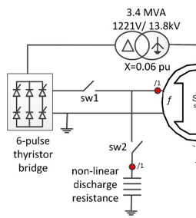
SSN Synchronous machines (2)
Something interesting about this Synchronous machine model…
→ The field winding is solved implicitly like others terminals.
Greater stability if the field feeding circuit is inductive or high-impedance
SSN node
Notes:
More info on the figure:
The modelled grid is a 79-bus multi-phase multi-voltage unbalanced network including components of 10 different types, each with electrical and mechanical parts, various controllers and protection systems, allowing to simulate the behavior of an active distribution grid. The model is implemented in MATLAB/Simulink and is modified for its use with the Opal-RT eMegaSim real-time simulator.

Slide 16
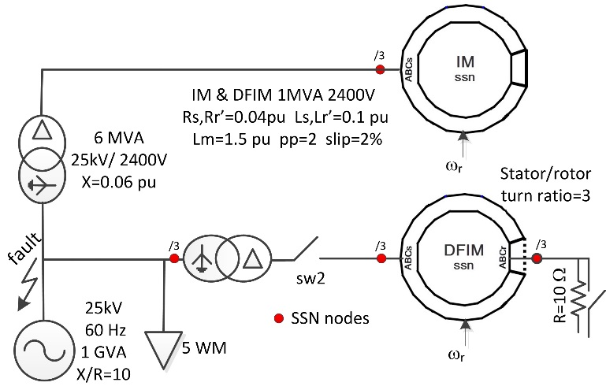
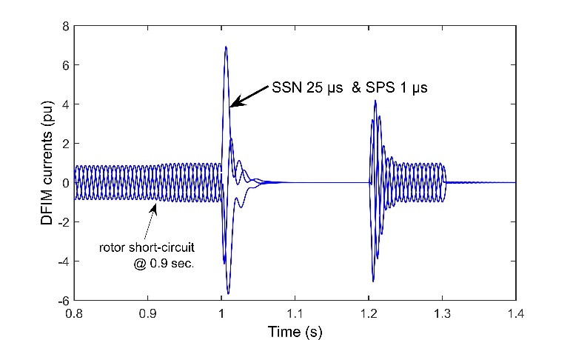
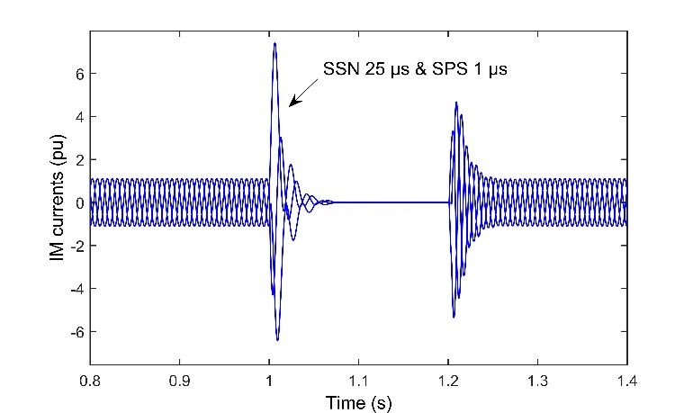
SSN Asynchronous machines
SSN model @ 25 µs matches perfectly SPS model running at 1µs
Main SSN improvement : at 25µs, SPS requires a dummy load of 50 kW (0.05 pu) to maintain numerical stability when DFIM stator breaker is opened
Comparison SSN@25µs vs.
SPS @1 µs
Test circuit
Notes:
More info on the figure:
The modelled grid is a 79-bus multi-phase multi-voltage unbalanced network including components of 10 different types, each with electrical and mechanical parts, various controllers and protection systems, allowing to simulate the behavior of an active distribution grid. The model is implemented in MATLAB/Simulink and is modified for its use with the Opal-RT eMegaSim real-time simulator.

Slide 17
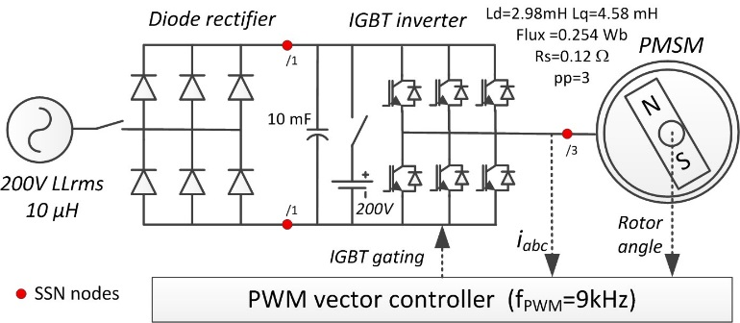
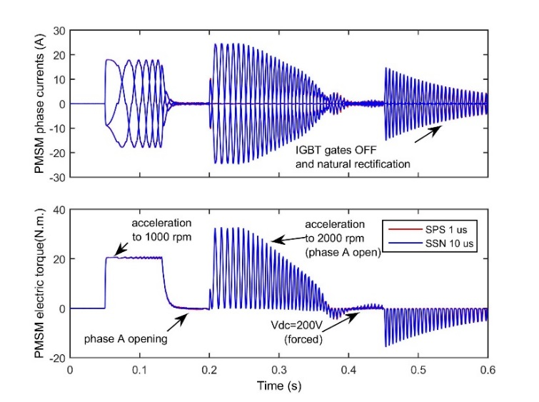
SSN Permanent magnet synchronous machines
SSN model @ 10 µs matches perfectly SPS model running at 1µs.
SSN interpolates inverter voltage (9kHz) with accuracy
Main SSN improvement : at 10 µs SPS requires a stator resistive load <1000Ω to maintain stability when IGBT gating is stopped. (>100kΩ in SSN)
Test circuit**
**M. Harakawa, H. Yamasaki, T. Nagano, S. Abourida, C. Dufour and J. Bélanger, “Real-Time Simulation of a Complete PMSM Drive at 10 μs Time Step”, Proceedings of the 2005 International Power Electronics Conference - Niigata (IPEC-Niigata, Japan, 2005)
Comparison SSN@10µs vs. SPS @1 µs
Notes:
More info on the figure:
The modelled grid is a 79-bus multi-phase multi-voltage unbalanced network including components of 10 different types, each with electrical and mechanical parts, various controllers and protection systems, allowing to simulate the behavior of an active distribution grid. The model is implemented in MATLAB/Simulink and is modified for its use with the Opal-RT eMegaSim real-time simulator.

Slide 18
Conclusion
SSN now enables users of SimscapePowerSystems (formerly SimPowerSystems) to model accurately Synchronous Machine, Asynchronous machine and Permanent Magnet Synchronous Machine without constraint on minimum load or RC-snubber for numerical stability
This contributes to further enhance Model-Based-Design in power systems and motor drives.

Slide 19
Thank you
To read further:
H.W. Dommel, EMTP Theory Book, 2nd edition.
C. Dufour, J. Mahseredjian , J. Bélanger, “A Combined State-Space Nodal Method for the Simulation of Power System Transients”, IEEE Transactions on Power Delivery, Vol. 26, no. 2, April 2011 (ISSN 0885-8977), pp. 928-935
M. Harakawa, C. Dufour, S. Nishimura, T.Nagano, “Real-Time Simulation of a PMSM Drive in Faulty Modes with Validation Against an Actual Drive System”, Proceedings of the 13th European Conference on Power Electronics and Applications (EPE-2009), Barcelona, Spain, Sept. 8-10, 2009
C. Dufour, O. Tremblay, “Iterative Algorithms of Surge Arrester for Real-Time Simulators”, 18th Power Systems Computation Conference (PSCC'14), Wroclaw, Poland, August 18-22, 2014.

Slide 20
Supplementary slides

Slide 21
Real-time performance
All test models are relatively small; they run in real-time in RT-LAB.
Model | Model calculation time (µs) | SSN nodes
SM | 8.5 | 8
IM +DFIM | 6.7 | 12
PMSM | 5.7 | 5
Table I: real-time performance on X10-Xeon
Notes:
More info on the figure:
The modelled grid is a 79-bus multi-phase multi-voltage unbalanced network including components of 10 different types, each with electrical and mechanical parts, various controllers and protection systems, allowing to simulate the behavior of an active distribution grid. The model is implemented in MATLAB/Simulink and is modified for its use with the Opal-RT eMegaSim real-time simulator.

Slide 22
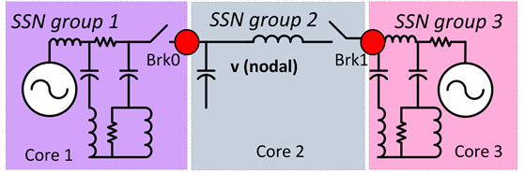
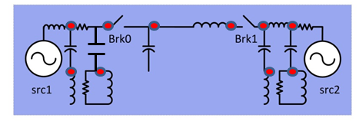
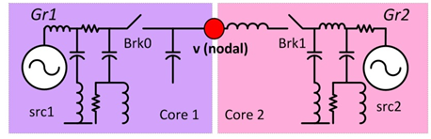
State-Space Nodal (SSN) Solver for Parallel RT-sim
Reducing the node number is critical for DRTS because the LU factorization of Y admittance matrix is an order O(R³) problem (R is rank of Y)
SSN allow user to select the node location and limit the number of nodes.
Less partitions make it easier to solve the equations on parallel cores,
without algorithmic delays.
Using EMTP/RTDS/Hypersim: 10 nodes, 16 ‘partitions’
Using SSN: 1 node, 2 partitions!
Comparison of node number for standard nodal admittance method and SSN
** C. Dufour, J. Mahseredjian , J. Bélanger, “A Combined State-Space Nodal Method for the Simulation of Power System Transients”, IEEE Transactions on Power Delivery, Vol. 26, no. 2, April 2011 (ISSN 0885-8977), pp. 928-935

Slide 23
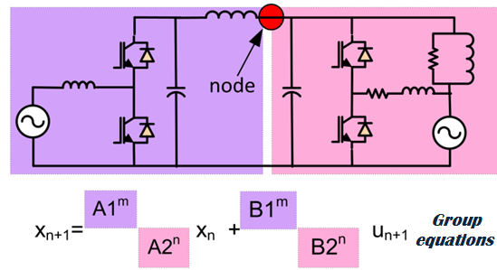
Parallel State-Space Nodal Solver (SSN)
SSN allow the parallelization of the network equations without delay.
How is this possible? Reducing the node number has the effect of creating much bigger branch equations. These SSN group equations are computed on many CPUs in parallel!
Note that this would be possible in theory for standard EMTP but in would be practically inefficient because of the inter-core communication costs for a large number of branches.
YV=I
SSN groups computed mostly in parallel
LU solution is made
on a different core

Slide 24
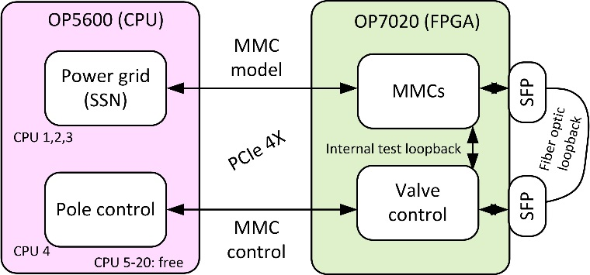
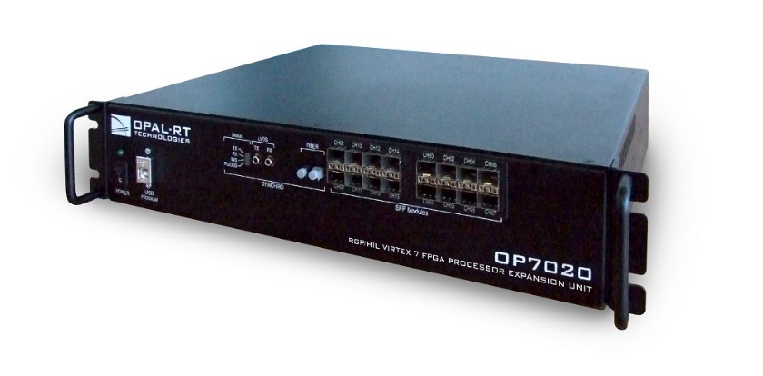
eMEGAsim hardware
eMEGASim is a Simulink real-time simulator using Intel processors
All domains of Simulink supported
Some model are available on FPGA
  Virtex-6 in main frame
  Virtex-7 on FPGA extender module
PCIe x4 (20 Gbits/s)
Main eMEGAsim 20 Intel core
Real-time simulator
Virtex-7 FPGA extender for eMEGAsim

