Slide 1

ARTEMiS and the
State Space Nodal solver suite
Christian Dufour
christian.dufour@opal-rt.com

Slide 2
Revision history
 |  | date | author
v1 | RT-17 original presentation | Sept. 2017 | C.Dufour
v2 | With edits, updates and appendices on TSB, Solvers and line models | Sept. 2018 | C. Dufour

Slide 3
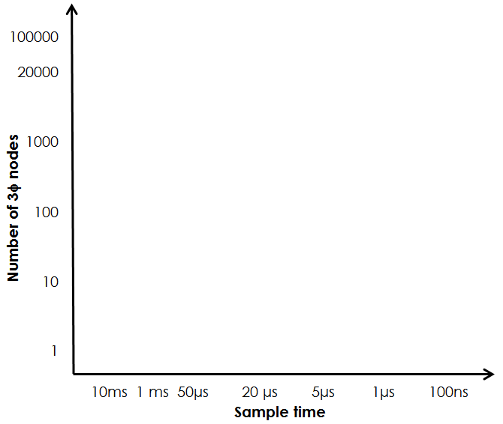
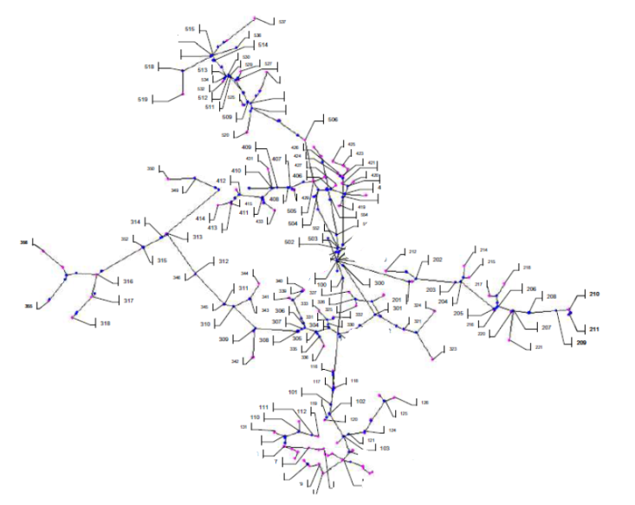
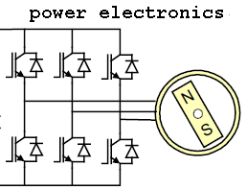
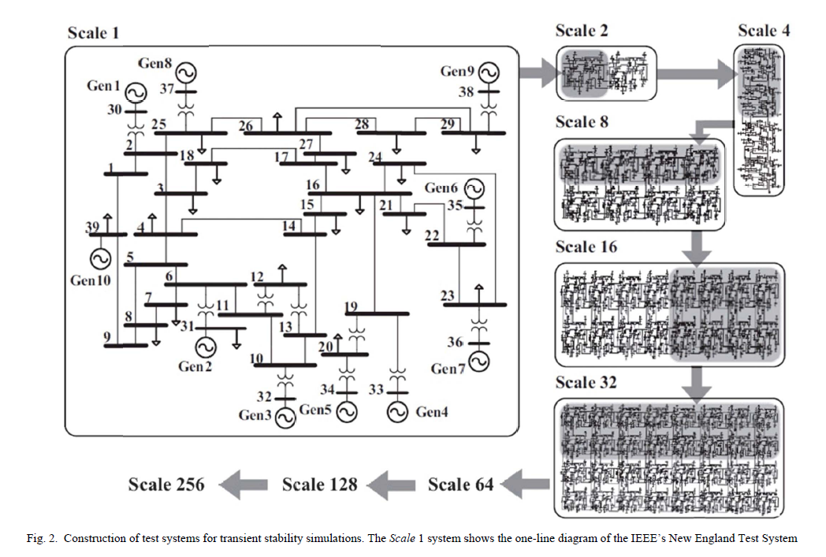
Different solutions for different problem sizes
Real-Time Transient
Stability
(or Phasor) Simulation
(like PSS/e)
Pejovic-type
EMT simulation
Real-Time ElectroMagnetic Transient Simulation
(like EMTP)
{
FPGA-type
CPU-type
ePHASORsim solver (Ts=1-10 milliseconds)
Hypersim and eMEGAsim with SSN from OPAL-RT Technologies
eFPGAsim featuring eHS for fast power electronics

Slide 4
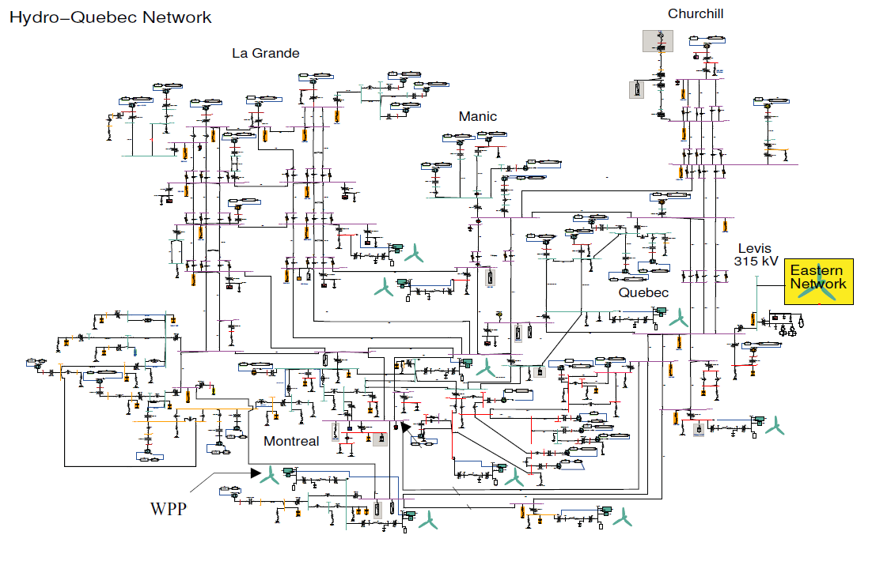
Challenge of distribution networks with EMT-DRTS
Transmission line delays allow large transmission system to run in real-time.
  Ex: HQ grid run in real-time on 64 core on SGI computer
  Automatic partition in Hypersim RT simulator

Slide 5

Challenge of distribution networks with EMT-DRTS
Transmission line delays allow large transmission system to run in real-time.
  Ex: HQ grid run in real-time on 64 core on SGI computer
  Automatic partition in Hypersim RT simulator
There is no such ‘long’ lines in distribution systems!
  Cannot parallelize tasks like in transmission grids
  ‘Stubline’ solutions inadequate in low capacitance grids, especially in fault testing.

Slide 6
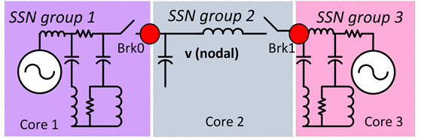
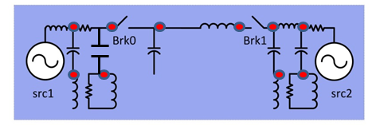
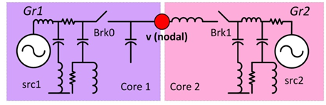
State-Space Nodal (SSN) Solver for Parallel RT-sim
Reducing the node number is critical for DRTS because the LU factorization of Y admittance matrix is an order O(R³) problem (R is rank of Y)
SSN allow user to select the node location and limit the number of nodes.
Fewer and bigger partitions make it easier to solve the equations on parallel cores without algorithmic delays.
Using EMTP/RTDS/Hypersim: 10 nodes, 16 ‘partitions’
Using SSN: 1 node, 2 partitions!
Comparison of node number for standard nodal admittance method and SSN
** C. Dufour, J. Mahseredjian , J. Bélanger, “A Combined State-Space Nodal Method for the Simulation of Power System Transients”, IEEE Transactions on Power Delivery, Vol. 26, no. 2, April 2011 (ISSN 0885-8977), pp. 928-935

Slide 7
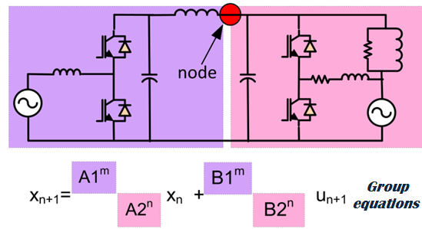
Parallel State-Space Nodal Solver (SSN)
SSN allow the parallelisation of the network equations without delay.
How is this possible? Reducing the node number has the effect of creating much bigger branch equations. These SSN group equations are computed on many CPUs in parallel!
Note that this would be possible in theory for standard EMTP but in would be practically inefficient because of the inter-core communication costs for a large number of branches.
YV=I
SSN groups computed mostly in parallel
LU solution is made
entirely on 1 core

Slide 8
State-Space Nodal (SSN) Solver for Parallel RT-sim
Speed advantage of SSN state-space partitioning over std. state-space methods
SPS model with n states
Number of operation for n state model without no input nor outputs
# of SSN groups | Serial mult-add ops | Total Parallel speed-up* | Typ. LU size**
1 | n^2 | 1 | 0
2 | 2*(n/2)^2=(n^2)/2 | 4 | 1
3 | 3*(n/3)^2=(n^2)/3 | 9 | 2
SSN with 2 state-space partition of n/2 state
SSN with 3 state-space partition of n/3 states
* Total parallel speed-up will be less than shown
because of hardware implementation
** LU operation is negligible when n is much larger
than the size of LU.

Slide 9
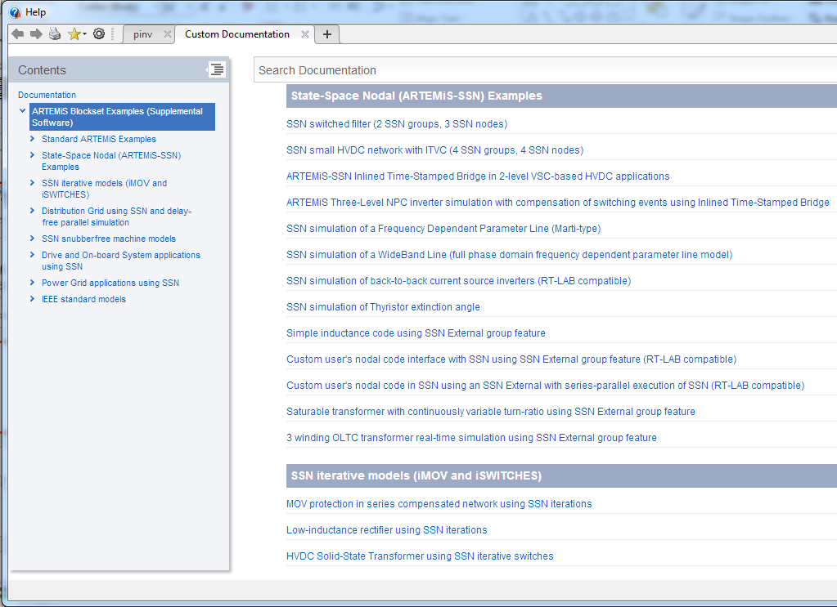
Best way to learn SSN
>> demo blockset artemis

Slide 10
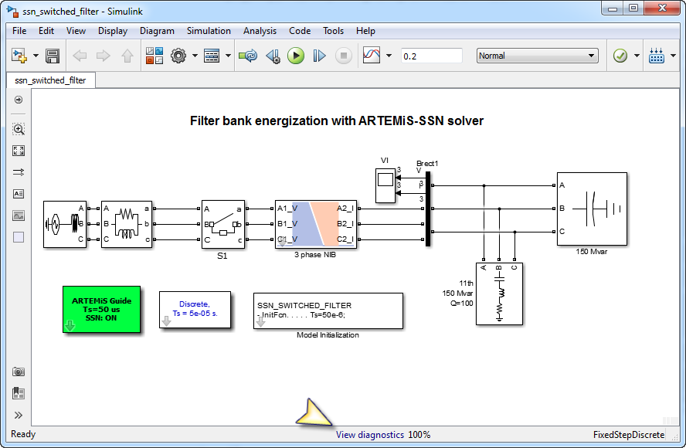
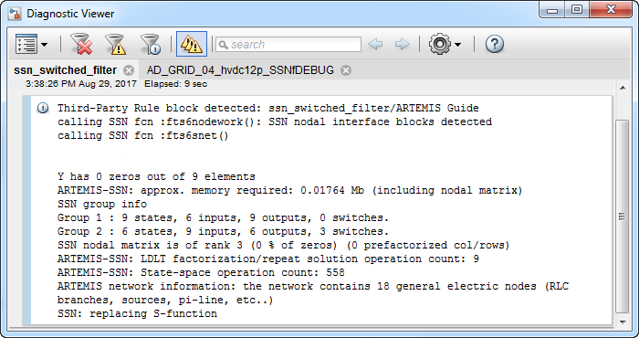
Optimization of SSN: Read SSN listing
Group number, size of matrices, matrix sparsity, number of operations
Above, we have 3 nodes, LDLT factorization is only 9 mult-add
State-space operation of 2 SSN groups is 558.

Slide 11
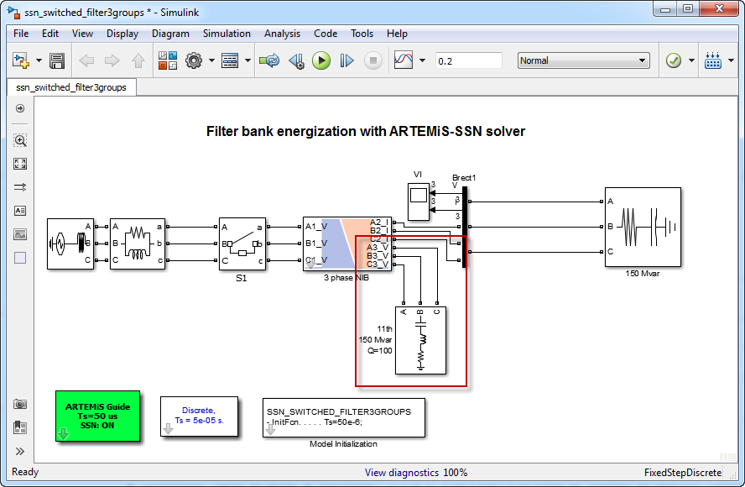
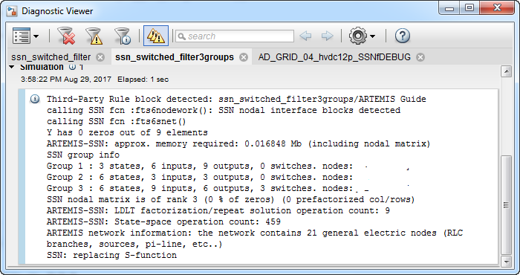
Optimization of SSN: Read SSN listing
Group number, size of matrices, matrix sparsity, number of operations
Above, we have 3 nodes, LDLT factorization is only 9 mult-add
State-space operation of 3 SSN groups is 459: FASTER

Slide 12
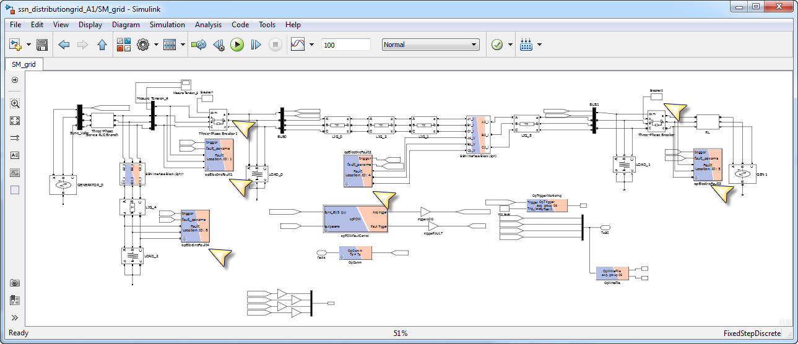
Prefactorisation of SSN admittance matrix
If you can leave some groups without switches… some nodes of the SSN admittance matrix could be pre-factorized
Check on the demo:
ARTEMIS-SSN: LDLT factorization/repeat solution operation count: 54 ARTEMIS-SSN: State-space operation count: 5337

Slide 13
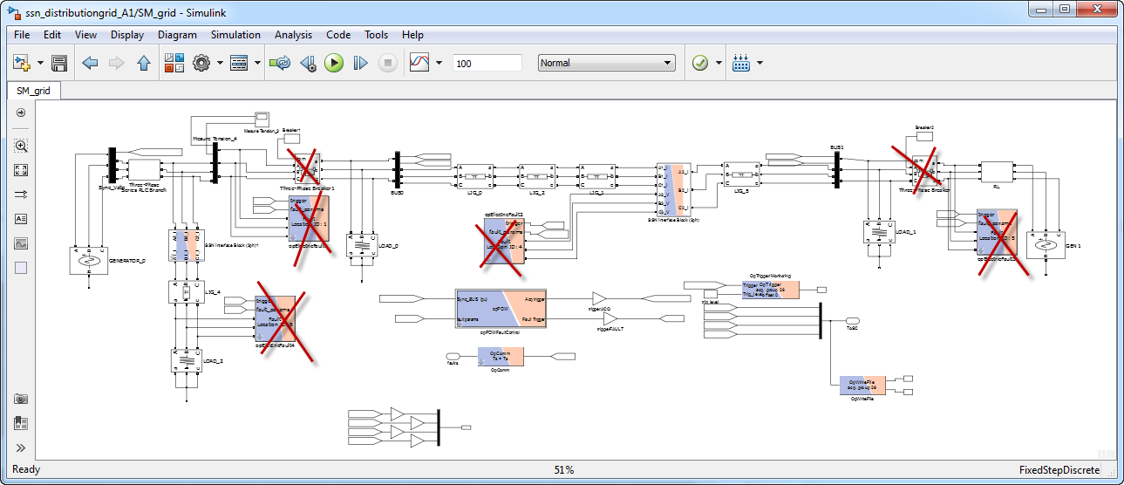
Prefactorisation of SSN admittance matrix
Same demo without the fault breakers
Check on the demo:
ARTEMIS-SSN: LDLT factorization/repeat solution operation count: 36
→ Less factorization operation because of prefactorization
ARTEMIS-SSN: State-space operation count: 3704 (Faster, why?)
→ Each breaker/switch adds some input/outputs to state-space groups

Slide 14
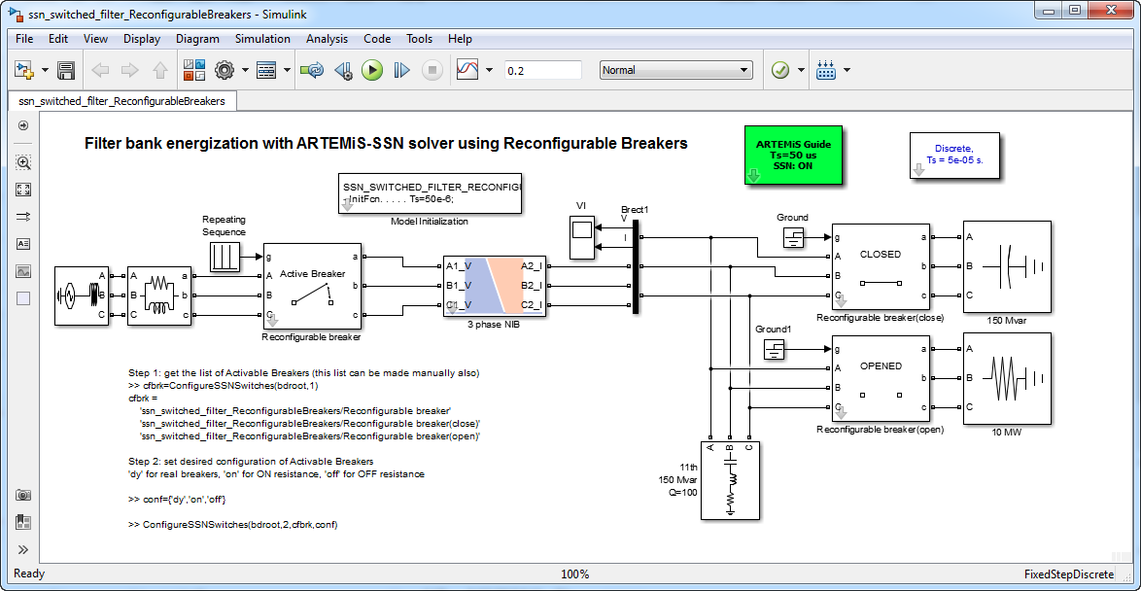
Switch management in SSN
Efficient switch management can be useful to optimize a circuit for RT
ARTEMiS come with switch management routines and blocks
In a single model, the method enable to configure breakers as simple resistances and vice-versa to optimize pre-calculations
function [a]=ConfigureSSNSwitches(varargin)
%
% ConfigSwitchScript Configure Breakers to be active or not, that is
% visible or not for the SPS and SSN solvers.
%
% Usage
% 1- get the list of SSN Reconfigurable Breaker
% cfbrk=ConfigureSSNSwitches(model,1) with model, the model name
% cfbrk =
% 'ssn_switched_filter_ReconfigurableBreakers/Reconfigurable breaker'
% 'ssn_switched_filter_ReconfigurableBreakers/Reconfigurable breaker(close)'
% 'ssn_switched_filter_ReconfigurableBreakers/Reconfigurable breaker(open)
% produce a list of the block in cell form. (Above example is for a model with 3 SSN Reconfigurable Breaker blocks)
%
% 2- set the configuration for the available SSN Reconfigurable Breaker
% ConfigureSSNSwitches(model,2,cfbrk,conf)
% with conf being an array of cell of the type
% conf={'on','dy','off'}
% Possible conf cell values are:
% 'dy' : means that the breaker is 'normal' or active from the SPS/SSN point of view.
% 'on' : means that the breaker is replaced by a constant resistance equivalent to CLOSED status
% 'off': means that the breaker is replaced by a constant resistance equivalent to OPENED status
% Open and closed resistance values are set in the SSN Reconfigurable Breaker block masks.

Slide 15
Decoupling methods for multi-core simulation
Many decoupling methods are available in ARTEMiS
SSN parallelization is made within each RT-LAB SS_ subsystems
DPL and stublines are used across RT-LAB SS_ subsystems
Accuracy
SSN
Parallelization
ARTEMiS Distributed Parameter Line (DPL)
Stublines (Transformers and large inductances)
Stublines (elsewhere)
Effectiveness

Slide 16
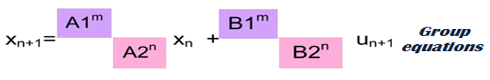
Decoupling methods for single-core simulation
By fractioning the equations within a single core, you can still increase the simulation speed.
Accuracy
SSN
Parallelization
ARTEMiS Distributed Parameter Line (DPL)
SSN Parallelization:
Compared with SPS,
we save there operations:
i.e. these are not 0 in SPS
or state-space ARTEMiS
Stublines (Transformers and large inductances)
0
Stublines (elsewhere)
Effectiveness
0
0
0
0

Slide 17
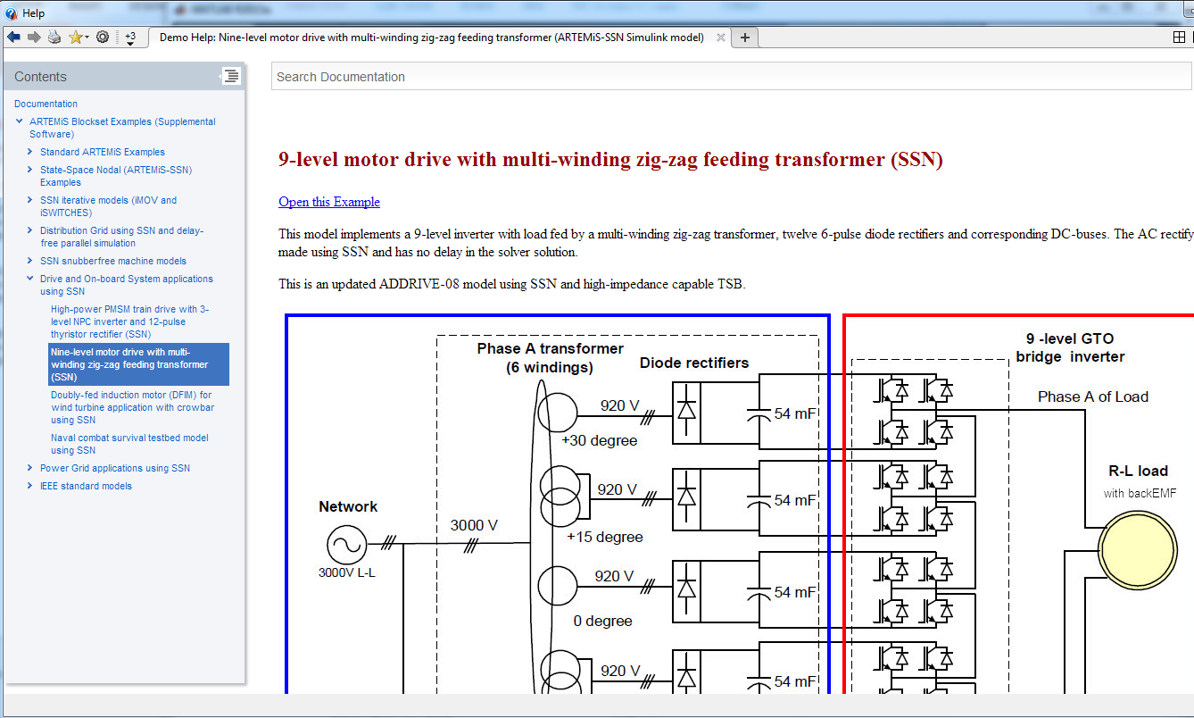
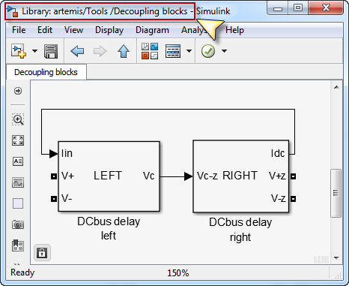
Other decoupling methods: DC-bus
Every model with DC-bus is a reason to smile.
Use the ARTEMiS DC BUS Decoupling blocks to simplify the task

Slide 18
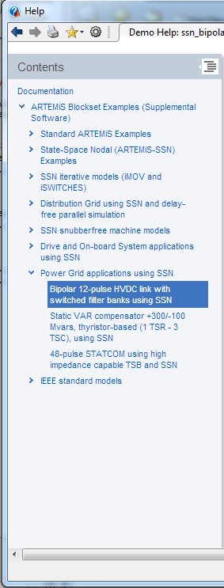
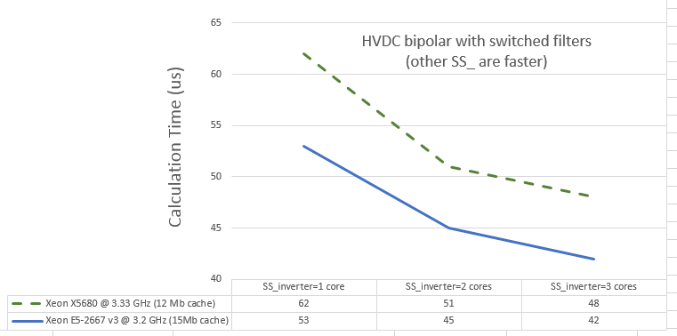
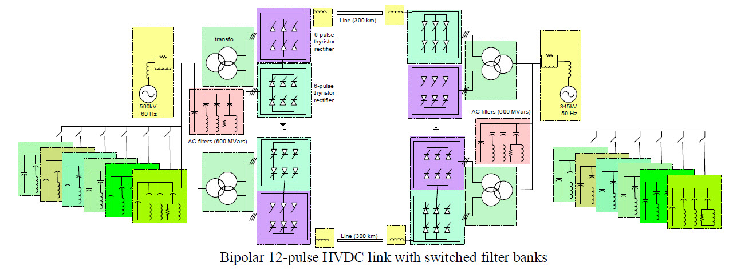
Decoupling using SSN
SSN parallelization: excellent accuracy
but less effective than full decoupling
limited gains after 3-4 cores per RT-LAB ‘SS_’
Ex: Bipolar HVDC on-line demo

Slide 19
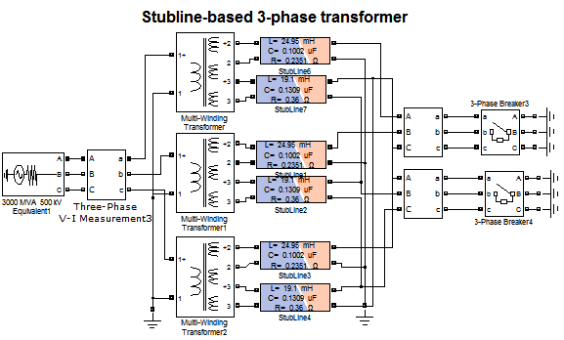
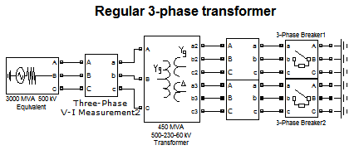
Stubline decoupling methods for multi-core simulation
ARTEMIS comes with stubline models: a stubline is a ergeron DPL with losses (i.e. standard SPS line model), with a propagation delay set exactly equal to 1 simulation step. Line capacitance is adjusted automatically for the delay.
Usage: one can replace a transformer secondary leakage inductance with stubline having the same inductance to split the model into 2 cores.

Slide 20
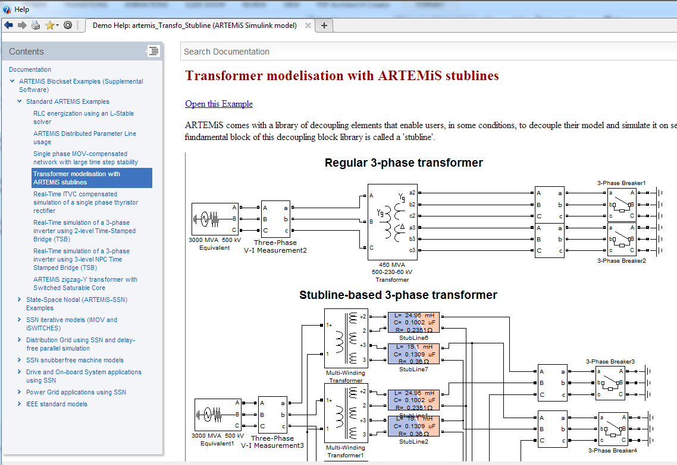
Stubline decoupling methods for multi-core simulation
Stublines: very good with transformer but you need to verify accuracy
Watch out for Delta-connection and PU: see demo please

Slide 21
Switch models
Several ways to model switches in SSN, in particular, inverters.
model | usage | limitations | advantages
TSB | 2- level 3-level NPC inverter | Requires RC adjustment for high-impedance mode | Highly accurate because of interpolation
TSB-RD (new) | 2- level 3-level NPC 3-level T-type | Requires SSN because of RD (Real diode) in complex drives | Highly accurate because of interpolation. Real diodes typically mean easier snubber adjustments
SSN-IVIC | 2- 3-level inverter | PWM frequency limited to 20% of sampling frequency | Highly accurate because of interpolation. No inpit-output delay as in TSB.
iSwitch | Any inverter | No interpolation | Usable with all switches in all configurations
Thyristor ITVC | HVDC mainly |  | Highly accurate because of interpolation

Slide 22
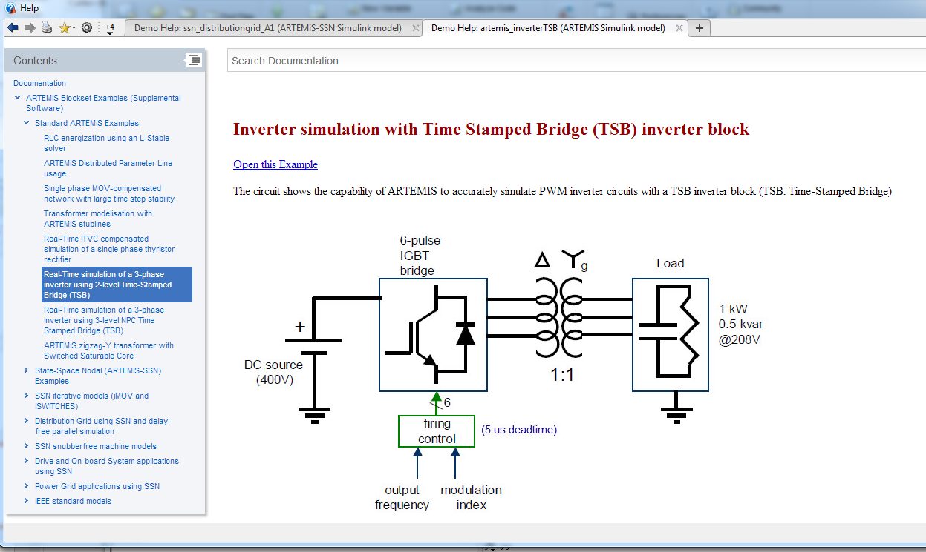
Switch models: TSB
TSB: simpler… but you need to adjust the RC snubber
TSB: simple… in simple situations.
RC snubber is required for High-impedance mode
How to set high impedance RC snubbers?
Start with R=1000 ohms C=inf
while (not stable)
->R=R/2
End
Set C so that R*C=3*time_step

Slide 23
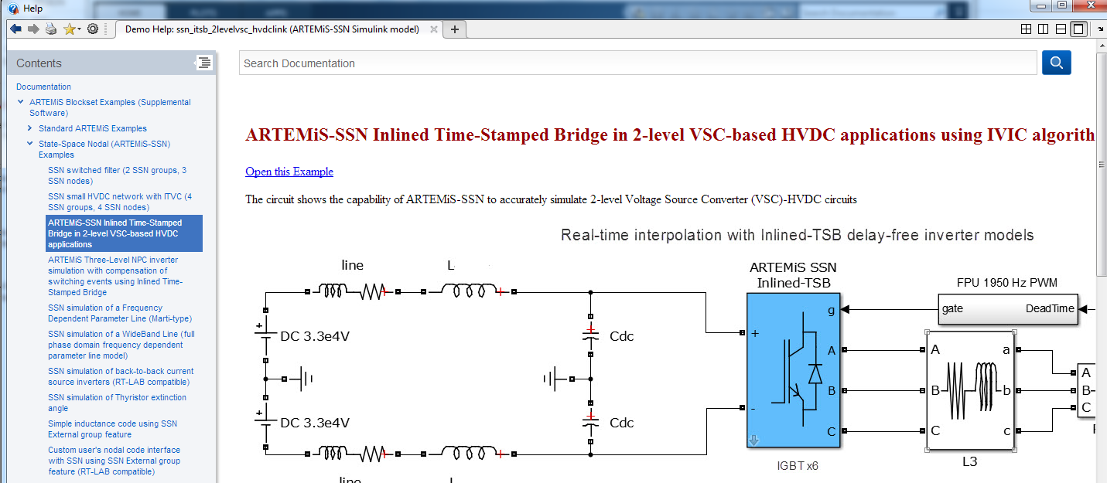
Switch models: IVIC
IVIC is the equivalent of TSB but ‘inlined’ in SSN
TSB has an input-output delay, IVIC has NO DELAY!
IVIC more limited in PWM than TSB: cannot go above ~0.2*(1/Ts).
IVIC critical in this HVDC demo (TSB not working because of delay):

Slide 24
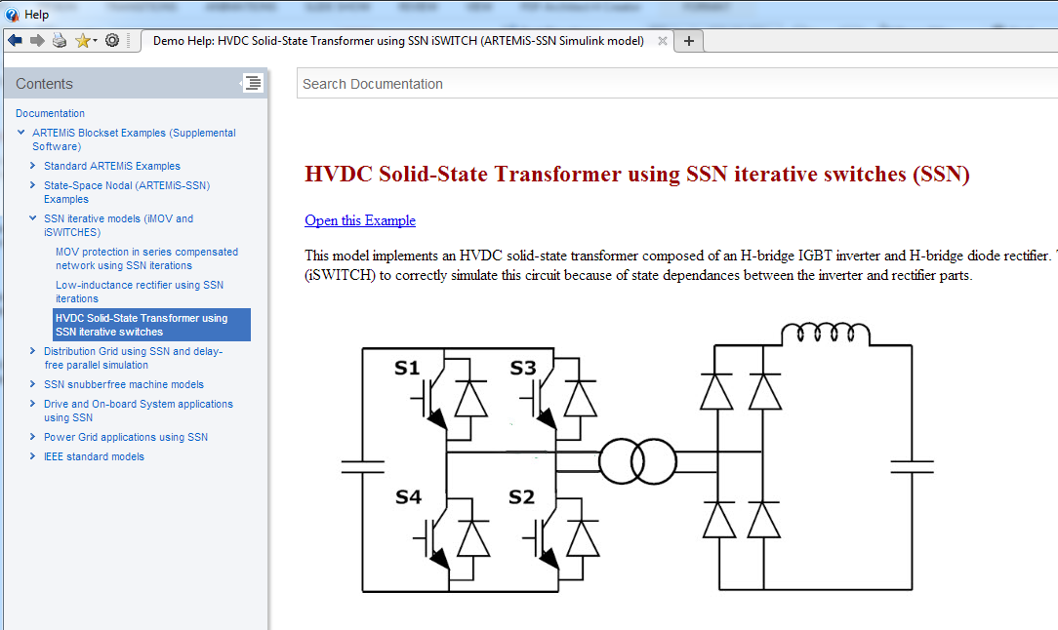
Switch models: iSwitch
iSwitch is Iterative Switch
Makes SSN more similar to general purpose simulator that always use iteration, like EMTP-RV. But can slow down simulation of course.
To be used whenever inaccuracies occurs with regular SSN.

Slide 25
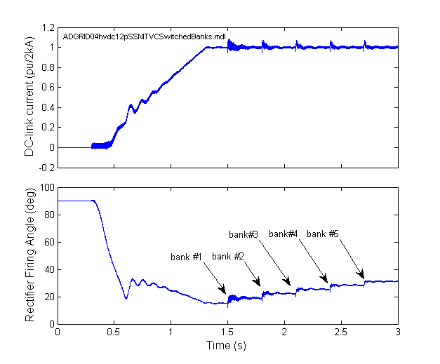
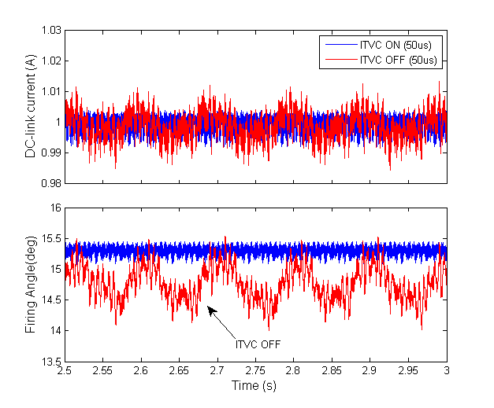
Switch models: Thyristor ITVC
ITVC Inlined Thyristor Valve Compensation
Used to compensate for thyristor firing in fixed time step.
Effect on bipolar HVDC demo:

Slide 26
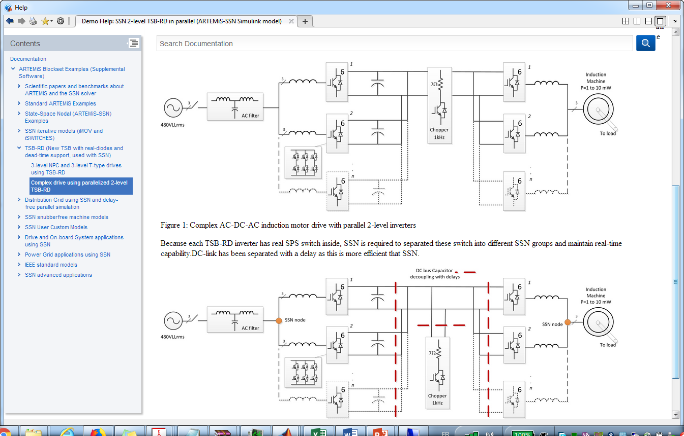
TSB-RD (RD=Real Diode)
TSB-RD are new TSB models with real SPS diode for support of high-impedance modes like shutdown or natural rectification.
Advantage: more robust high-impedance mode support with smaller RC snubber typically.
Disadvantage: SPS diode can cause some memory pre-computation issues. The solution is to use TSB-RD with SSN.
Demo made for Rockwell
(submitted to RT-18, Paris)

Slide 27
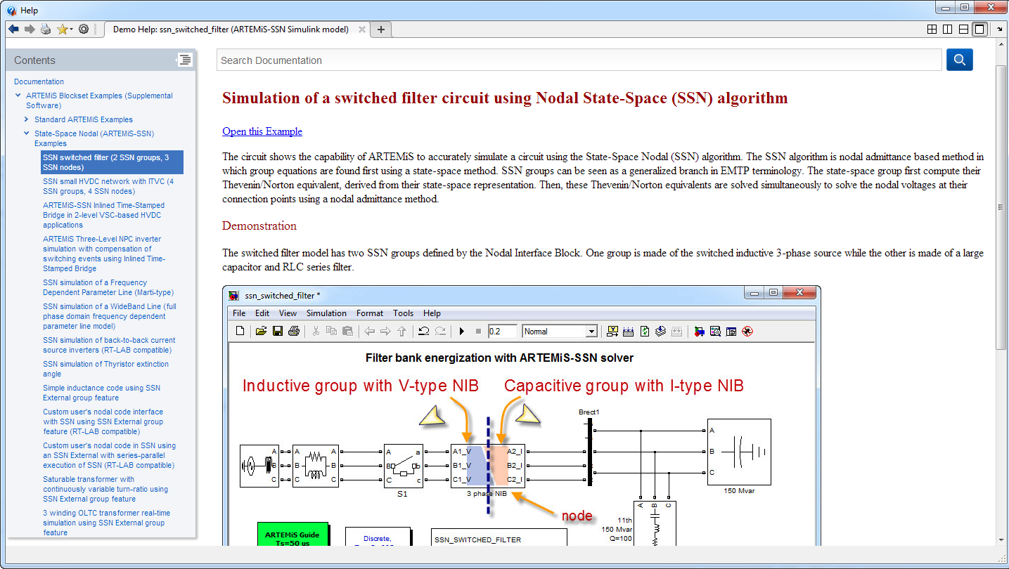
SSN groups
Basic V-type/ I-type rules
Try to ‘look through’ switches to get the best type.

Slide 28
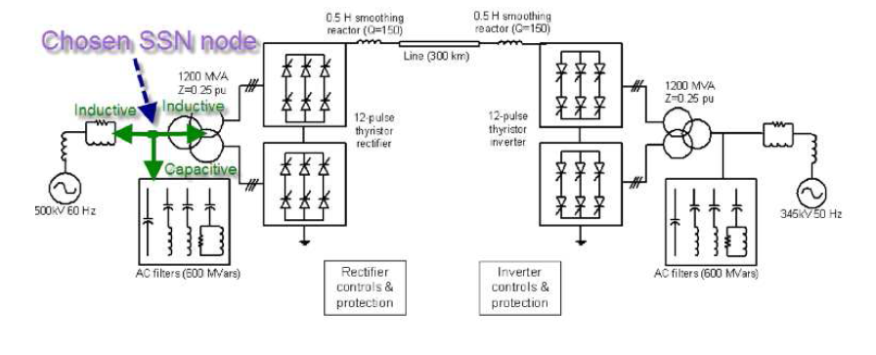
SSN groups: NIB usage examples
HVDC case
SVC case

Slide 29
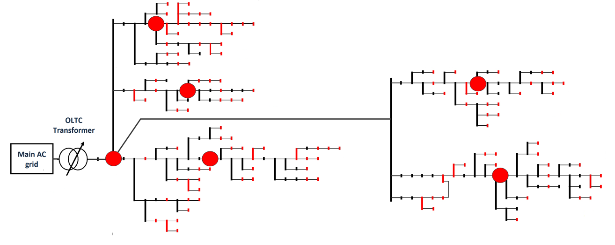
SSN groups
Exceptions and tricks 1: NON-SWITCHING NODES
Non switching nodes are nodes NOT connected to any switching group nor any SSN custom user group.
This results in prefactorization of the red nodes below. Prefactorisation=>FAST
In this case, it can be advantageous to have many non-switching nodes. The added green nodes may actually increase speed.
switch
OLTC SSN
Custom model

Slide 30
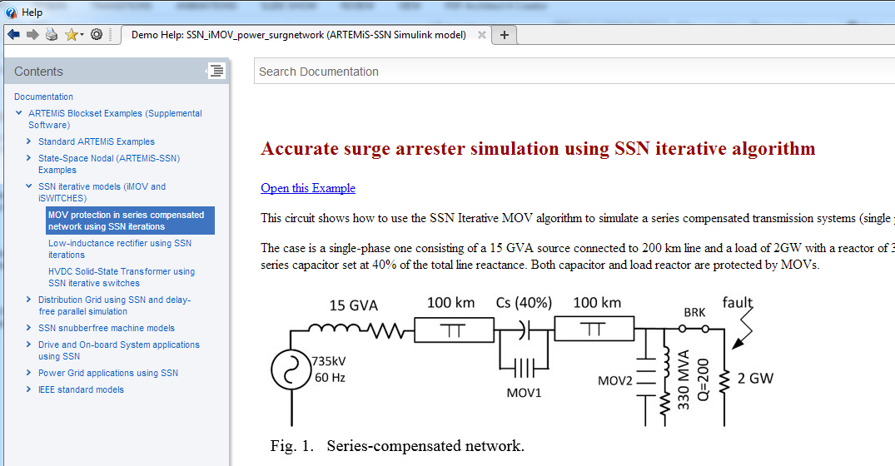
iMOV: iterative surge arresters

Slide 31
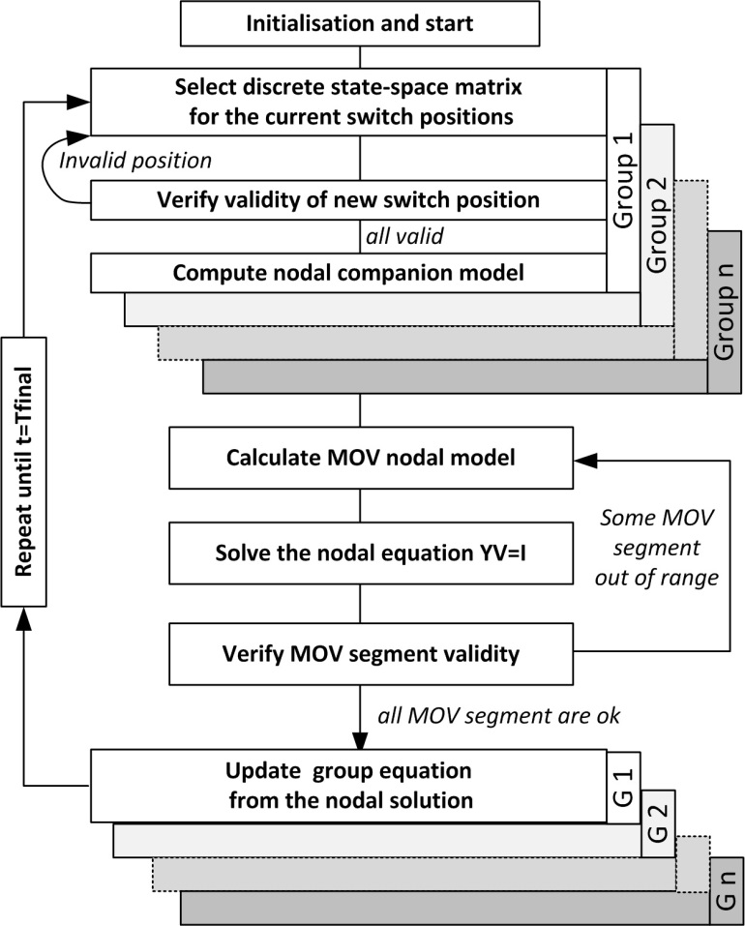
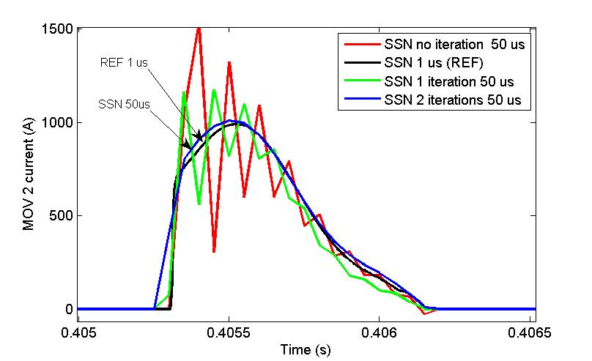
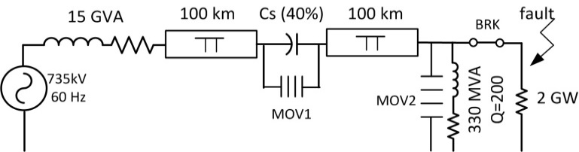
Iterative methods in real-time simulators
Iterative MOV enable precise real-time fault testing
Otherwise similar to other EMTP-type DRTS
Branch equation
Branch 1
Branch n
Branch equation
Branch 1
Branch n
C. Dufour, O. Tremblay, “Iterative Algorithms of Surge Arrester for Real-Time Simulators”, 18th Power Systems Computation Conference (PSCC 2014), August 18-22, 2014, Wroclaw, Poland.

Slide 32
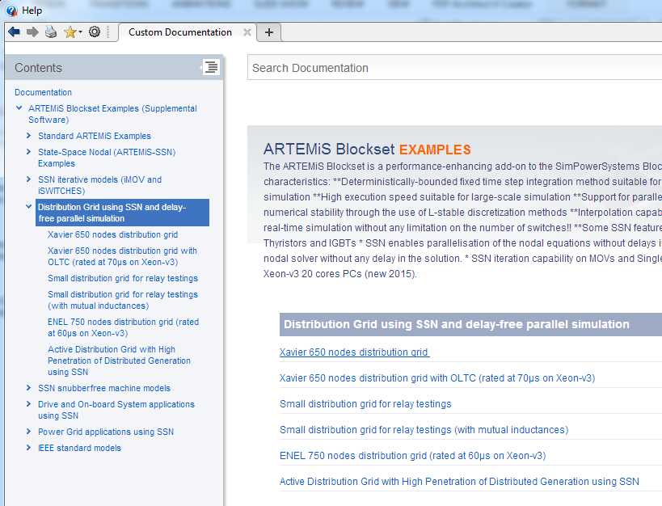
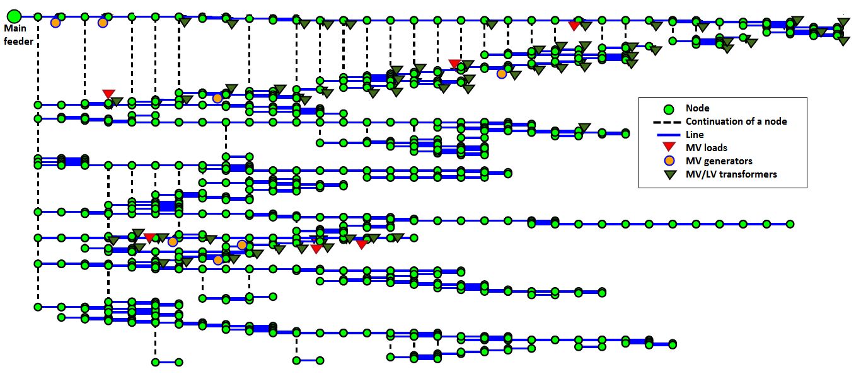
Distribution Grid EMT simulation with SSN
France Distribution, 650 nodes, 369 states, 70 µs
SSN nodes
Standard EMTP nodes
SSN groups/
partitions
ENEL Distribuzione, 750 nodes, 984 states, 52 µs

Slide 33
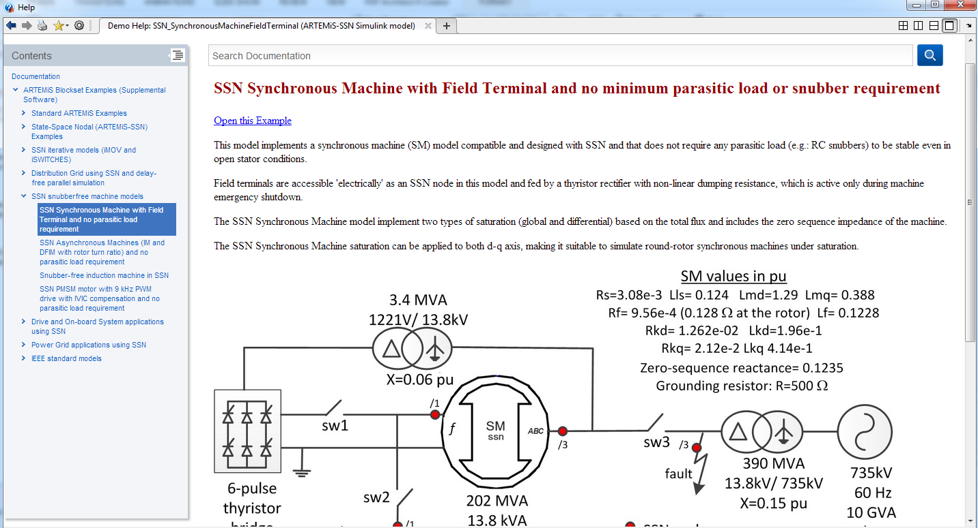
Snubberless SSN-machines
These SSN machine can run without parasitic load.
Correct a very old default of SPS caused by current injection technique they use.
Available : Synchronous machines, Induction machines, DFIM, PMSM
SM machine in SI unit: use EMTP-RV to get precise PU->SI conversion or ssn_SynchronousMachine_STD2SI_conversion.m routine in ARTEMiS

Slide 34
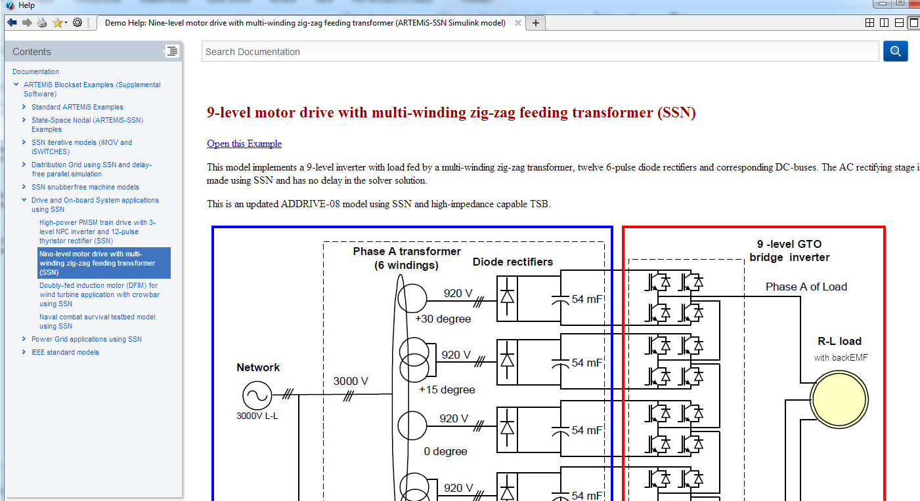
Upgraded AD-DRIVE demos
Demo uses later solvers and TSB.
AD_DRIVE -01 -07 -08 -12 are updated.

Slide 35
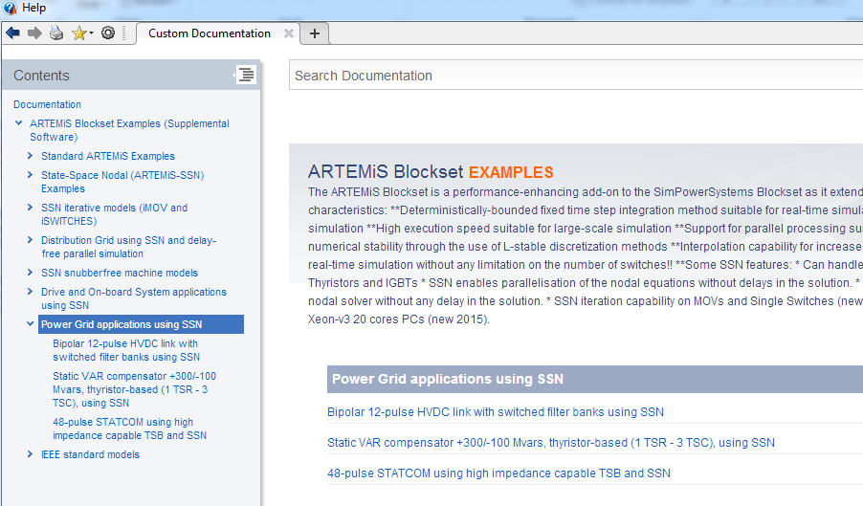
Upgraded AD-GRID demos
Demo uses later solvers and TSB.
AD_GRID -01 -03 are updated.
Bipolar HVDC with switched filters also available.

Slide 36
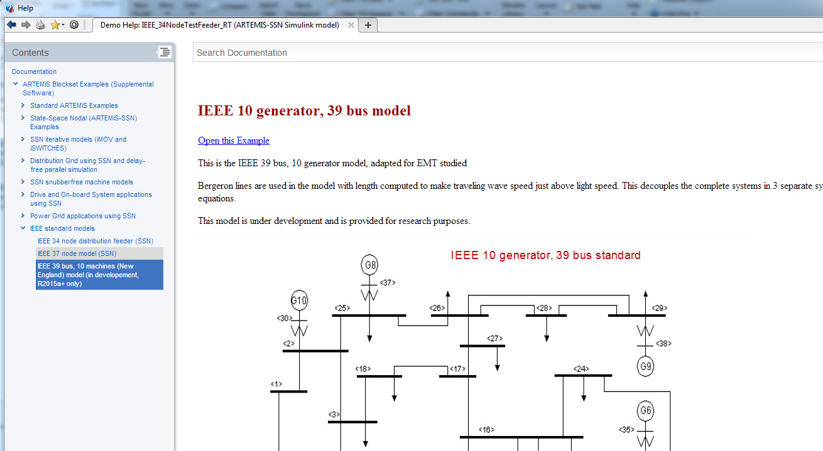
IEEE demos
Useful demos
EMTP-RV was used to get correct PU->SI conversion on the IEEE 10 generator, 39 bus model.

Slide 37
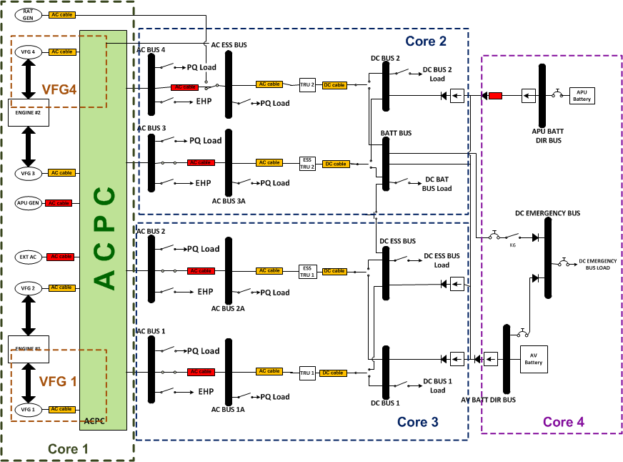
Also look for papers like SSN in More-Electric-Aircraft (Bombardier Global Express)
Bombardier GLEX stats:
  25 SSN groups
  109 switches (all coupled)
  SSN admittance matrix size: 48x48
  Time step 39 µs
L. Montealegre Lobo, C. Dufour, J. Mahseredjian, “Real-time Simulation of More-Electric Aircraft Power Systems”, Proceedings of the 15th European Conference on Power Electronics and Applications (EPE’13 ECCE Europe), Lille, France, Sept. 3-5, 2013

Slide 38
(end of original RT-17 presentation)
Merci beaucoup.
Thank you very much.
Danke sehr.
Muito obrigado.
christian.dufour@opal-rt.com

Slide 39
Appendix: Advanced Line models in SSN

Slide 40
Advanced Line models in SSN
SSN can implement FD-line models that are only efficient in the nodal world. State-space representation would be simply too big.
Line type | Accuracy | Computational load | Preferred applications | Availability
π line | medium | Low- medium | General 50-60 Hz simulation, transients | SPS, PLECS, ARTEMiS
Bergeron (with losses) (Constant Parameters CP line) | good | low | Transient simulation | SPS, ARTEMiS EMTP-RV
Frequency Dependant (Marti-type) | Very good | Medium | High-accuracy transients simulation (over-head lines) | SSN EMTP-RV
Frequency dependant (Phase-domain/WideBand type) | Excellent | High | High-accuracy transients simulation especially cable and unbalanced lines | SSN EMTP-RV

Slide 41
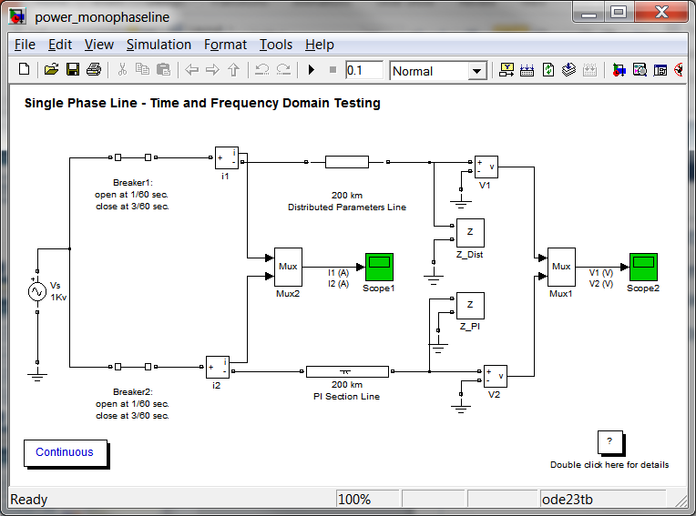
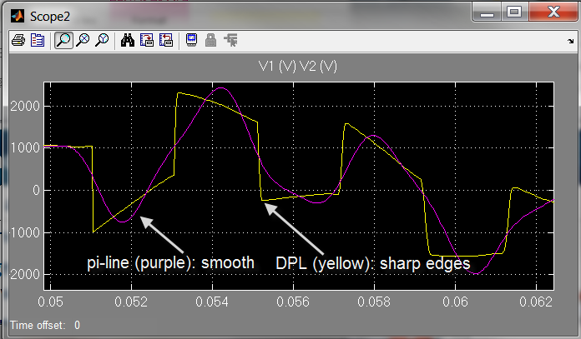
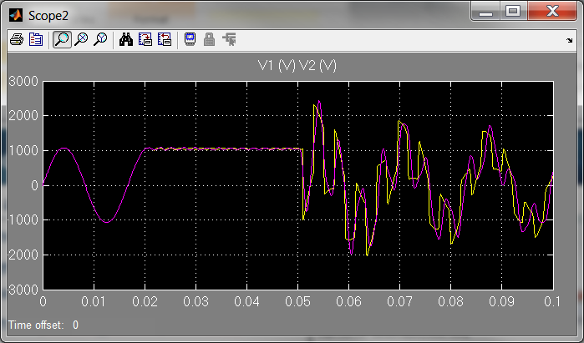
Line models for dummy
Pi-line and Bergeron-type line with losses
Pi-line are the simplest model.
Bergeron-line represents correctly the traveling-wave effect on line: one will be able to observe wave edge.
Open >> power_monophaseline

Slide 42
Line models for dummy
FD-line models
Include wire skin effect and ground return frequency dependence.
Typically Bergeron-line model will not damp enough high-frequency components
FD-line (Marti): functions computed in the modal domain
ULM (WideBand): functions computed in the phase domain directly
Line characteristic impedance
Line propagation function
Zc
H
Bergeron
Bergeron
ω
ω

Slide 43
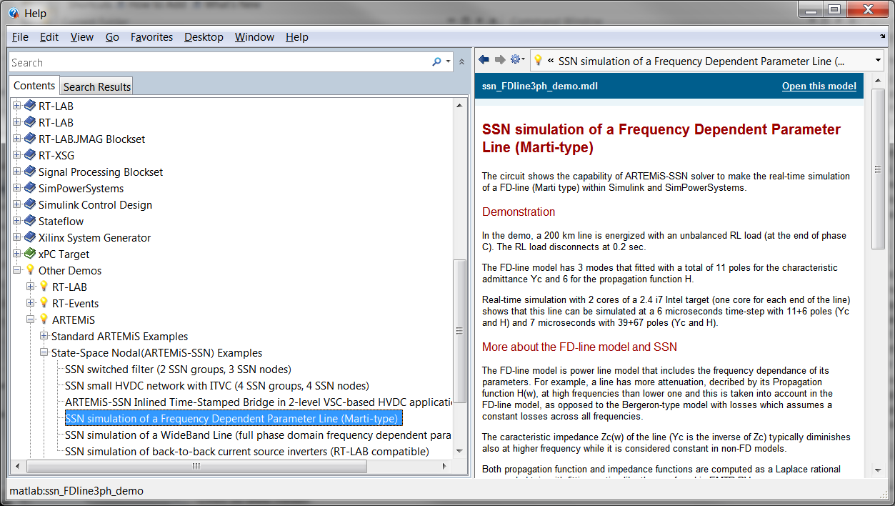

Line models for dummy
Example case in ARTEMiS demos
The FD line models uses X-type NIB interfaces

Slide 44
Appendix: More about ARTEMiS solvers

Slide 45
Simulation solvers for power systems
Key characteristics of modern power systems
  Contains a wide range of frequency modes
    Requires ‘stiff’ fixed-step solvers. Stiff solver remains stable even with mode above the simulation Nyquist limit.
  Contains a lot of PWM-driven power electronics
    The simulator must avoid sampling effect when computing IGBT pulse ‘events’ internally or when reading PWM pulses from its I/Os

Slide 46

Solvers methods for power system simulation
Simulation methods electric systems:
  Nodal approach (EMTP, HYPERSIM)
  State-Space (SimPowerSystems, PLECS)
  Switching-function (inverter models only)
  FPGA-based methods

Slide 47
Solvers methods for power system simulation
Classic method ‘Nodal Approach’
  Each RLC branch is discretized with the trapezoidal rule of integration (stiff solver)
  Example: inductor
  S-domain equation:
  Discretization by Trapeze( time step: T):
  Hummmm….. I_{n} depends on v_{n} , a priori unknown nodal voltage
    Implicit problem, cannot iterate directly 😐
Equivalent discrete
circuit
i_{n}
+
v_{n}
R
Ihist_{n-1}
-

Slide 48
Solvers methods for power system simulation
‘Nodal Approach’: solution to implicitness
  All branches resistance ratio R=v_{n}/i_{n} , are build into a nodal matrix
  Known term I_{h}=i_{n-1}+(T/2L)v_{n-1} are built into a vector I
  For all nodes, a global matrix of admittance is built: YV=I
  Nodal voltages are found by solving this matrix problem, either by direct inversion or LU decomposition.
  Re-solving of Y required if a switch change position
Y V= I
2
3
R
-R
Ih
-R
R
-Ih
4

Slide 49
Solvers methods for power system simulation
State-Space approach
  We can also find the exact state-space solution
  With k, matrix set index for switch permutations
  This can be discretized with the trapezoidal method like in SimPowerSystems for Simulink or PLECS
    Trapezoidal method: order 2.
  It can also be discretized by higher order methods
    Higher order methods (order 5) implemented in ARTEMiS, a solver package of eMEGAsim.

Slide 50
Solvers methods for power system simulation
State-Space approach
  Continuous time state-space expression:
  Solution for time step T:
  How to compute the ‘matrix exponential’ e^{AT} ?
  Trapezoidal method (order 2):
  ARTEMiS art5 method (order 5):
TALYOR EXPENSION

Slide 51


Effect of higher order discretization in ARTEMiS
ARTEMIS accuracy : ARTEMIS solvers are designed to improve the accuracy of simulation of power system at large time steps
Key ratio: Fosc/Fsampling
The smaller, the better.
For all solvers.
Fsampling: inverse of sample time
Fosc: mode frequency
ART5 solver more precise than TUSTIN solver at 100 us

Slide 52


Numerical stability issues
Discretized systems is not guarantied to be stable
  It depends on how Laplace poles are ‘mapped’ in the z domain. Ex: Forward Euler has poor stability
  A-stability (Stiff stability) (ex: trapeze method) guaranty discrete stability (for linear systems)
Laplace pole (s) mapping
RLC network Euler T=0.01µs
RLC network Trapeze T=100µs
Trapeze
Stability Region
Im{λ}
y’=λy
-2/T
Re{λ}
Forward Euler
Stability Region

Slide 53
Numerical stability issues
A-stable methods like trapeze can be highly oscillatory
  How are mapped high frequency poles?
  It depends on the ‘stability function’
Trapeze (A-stable)
ARTEMiS art5 (L-stable)
Laplace map
Z- domain map
Im{λ}
Im{z}
y’=λy
y(n+1)=zy(n)
X
Re{λ}
X
X
Re{z}
-1
z mapping near -1
means oscillations

Slide 54
Numerical stability issues with trapezoidal integration
Even if it is stable, the trapezoidal rule (tustin) is prone to numerical oscillations. Ex: inductive opening
  The z-domain mapping is stable but oscillatory for high frequency Laplace poles

Slide 55
Appendix: TSB and interpolation

Slide 56

Switching function modeling of power converters
  A special solver method for power electronic system using high-frequency PWM.
  It is a ‘simple’ controlled voltage source!
  Interpolation methods are used to obtain high accuracy
  Resistive losses can be included.
  High impedance, diode rectification modes supported
V+
~V+
Gup
V_load
V_load
Load
~0
*
*
*
Glow
1
Gup
gate
Glow
0
* V_load for positive I_load

Slide 57


Real-Time Interpolation and RT-Events
Signal 1
Signal 2
Ideal Pulse
(Signal 2 > Signal 1)
Time-Stamped Pulse
Time-Stamp
Discrete Comparator Pulse (State)
RT-Events Comparator

Slide 58


Effect of switch gate sampling and interpolation
  Switching function inverter (also called TSB) model use ‘time stamps’ to produce very accurate results
    Example: a simple DC chopper (PWM=10kHz, Ts=10µs)
    Bad sampling (like if we use regular SPS or PLECS) causes important non-linearity in the input-output characteristic but very linear characteristic with TSB inverters
SimPowerSystems
TSB
T_{carrier}/T_{s}=10

Slide 59



Effect of switch gate sampling and interpolation
  Precise enough to take into account deadtime effect smaller than the sample Time!
    Below is the effect of dead time increment of 2 µs (with a sample time of 10µs!)

Slide 60
TSBs in HIL applications
  To use TSB in HIL applications, PWM pulse are captured on the FPGA card by 100MHz counters
  Normalized ratio (Time Stamp) is send to the inverter models on the CPU
  The TSB model on the CPU use the Time Stamps to compute interpolated voltages.

Slide 61
Interpolated switching functions for PMSM drives
HIL Simulation
Physical System
  Mitsubishi Electric Co
  Japan, 2004
  ARTEMiS used for rectifier side
  Switching function used for inverter
PWM
2.25kHz
© Opal-RT
© Opal-RT
MITSUBISHI
PWM
4.5kHz
PWM
9kHz

Slide 62

3-level NPC using TSBs: see demos

